Slide 1

Pharmacy Management System
Gorkem Özyurt
218MI1034

Slide 2
WHAT IS PHARMACY MANAGEMENT SYSTEM?
pharmacy management system is a software system used to manage and organize the day-to-day operations of a pharmacy.
This includes tasks such as maintaining medicines, processing prescriptions, managing patient records, and generating reports and create delete update these kinds of things.

Slide 3
THE GOAL OF PHARMACY MANAGEMENT SYSTEMS
To improve the efficiency and accuracy of the pharmacy's operations, by automating and streamlining tasks such as inventory management, prescription processing, and patient record management.
by integrating with electronic medical records systems, a pharmacy management system can provide a more comprehensive view of a patient's medication history.
enabling more effective medication management.
reducing the risk of adverse drug interactions.
the goal of pharmacy management systems is to improve patient outcomes, increase productivity and reduce the costs of running a pharmacy.

Slide 4
TECHNOLOGIES USED AND THEIR DEFINITIONS
C#
.Net Freamwork
ORM
Entity Freamwork
Microsoft Reporting Services

Slide 5
orm
Object-Relational Mapping (ORM) is a technique for converting data between a relational database and an object-oriented programming language. he main idea behind ORM is to create a mapping between the database schema (tables, columns, etc.) and the classes and objects in the application. This allows developers to work with databases using a more familiar object-oriented paradigm, rather than writing low-level SQL statements.

Slide 6
Entity Framework
Entity Framework is an ORM and ORMs are intended to increase developer productivity by reducing the unnecessary tasks of persisting data used in applications

Slide 7
Microsoft Reporting Services:
Microsoft Reporting Services for .Net windows form application. Contains the assemblies required to use the Windows Form Report Viewer Control.

Slide 8
DESIGN PATTERNS TO BE USED IN THE PROJECT
Repository design pattern
Layered architecture

Slide 9
Layered architecture
layered architecture is a design pattern that helps to separate the different concerns of an application and make it more maintainable, testable, and scalable.

Slide 10
Repository design pattern
It is a design pattern that enables data access and management to be reduced to a single point in data-centric applications

Slide 11

Some Forms IN ThIS PROJECT

Slide 12
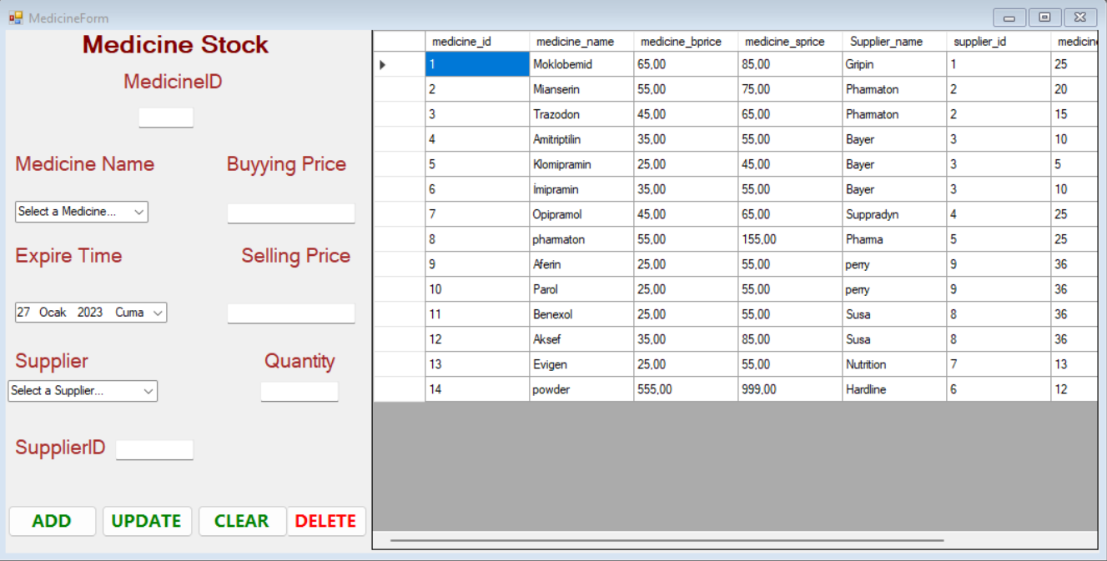
Medıcıne form

Slide 13
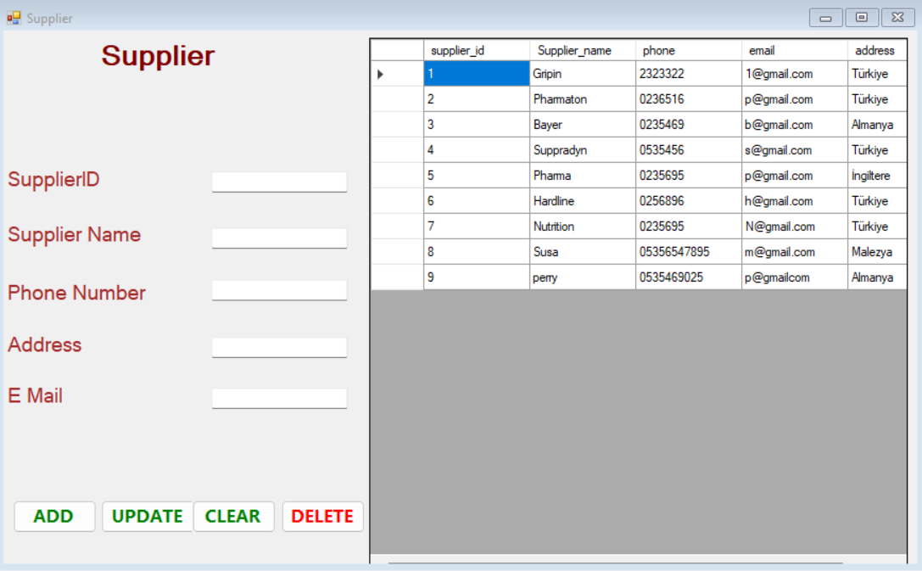
Supplıer form

Slide 14
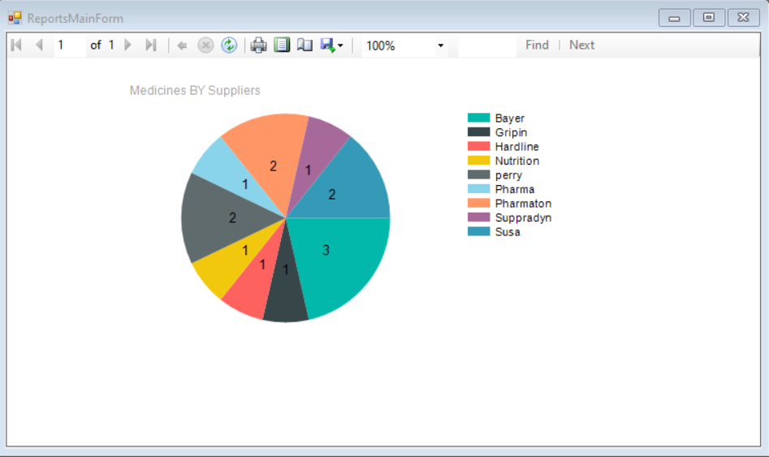
Reports form

Slide 15

Now, I Want to Show my Project via mıcrosoft vısual studıo…

